Slide 1


Pre-Entry

Slide 2


Slide 3
She is
first.

Slide 4
She is
second.

Slide 5
She is
third

Slide 6

What is your first language?

Slide 7
What is your second language?

Slide 8
Do you speak another language?

Slide 9
E
S
O
L
nglish as a
econd or
ther
anguage

Slide 10

jobs

Slide 11
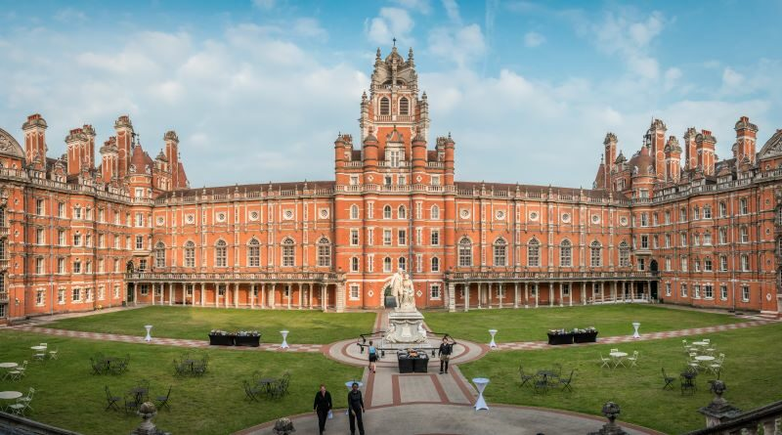

BA
BSc
university

Slide 12
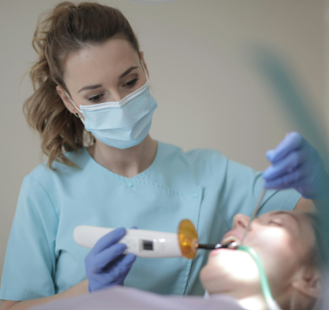




Slide 13

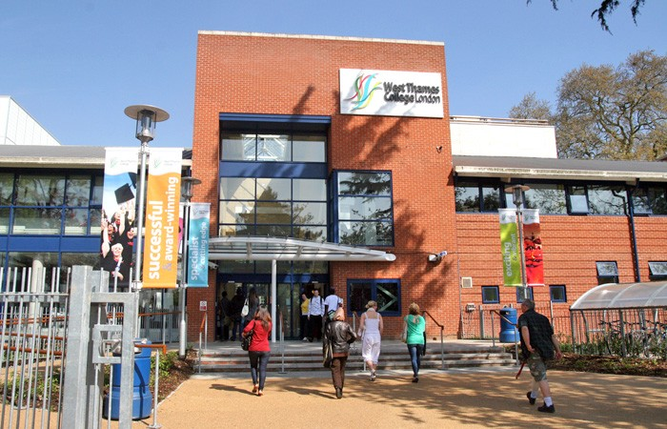
college
ESOL Skills for Life

Slide 14
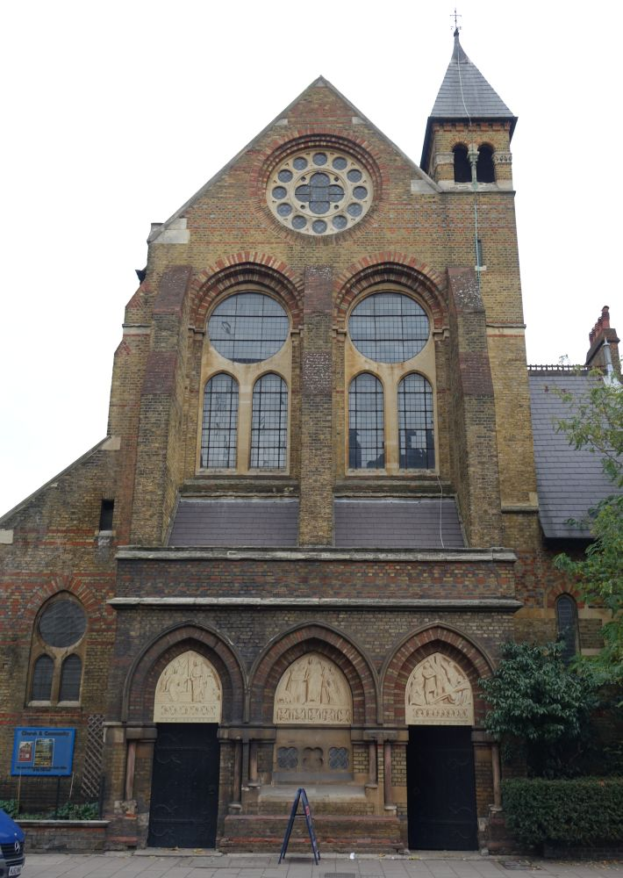
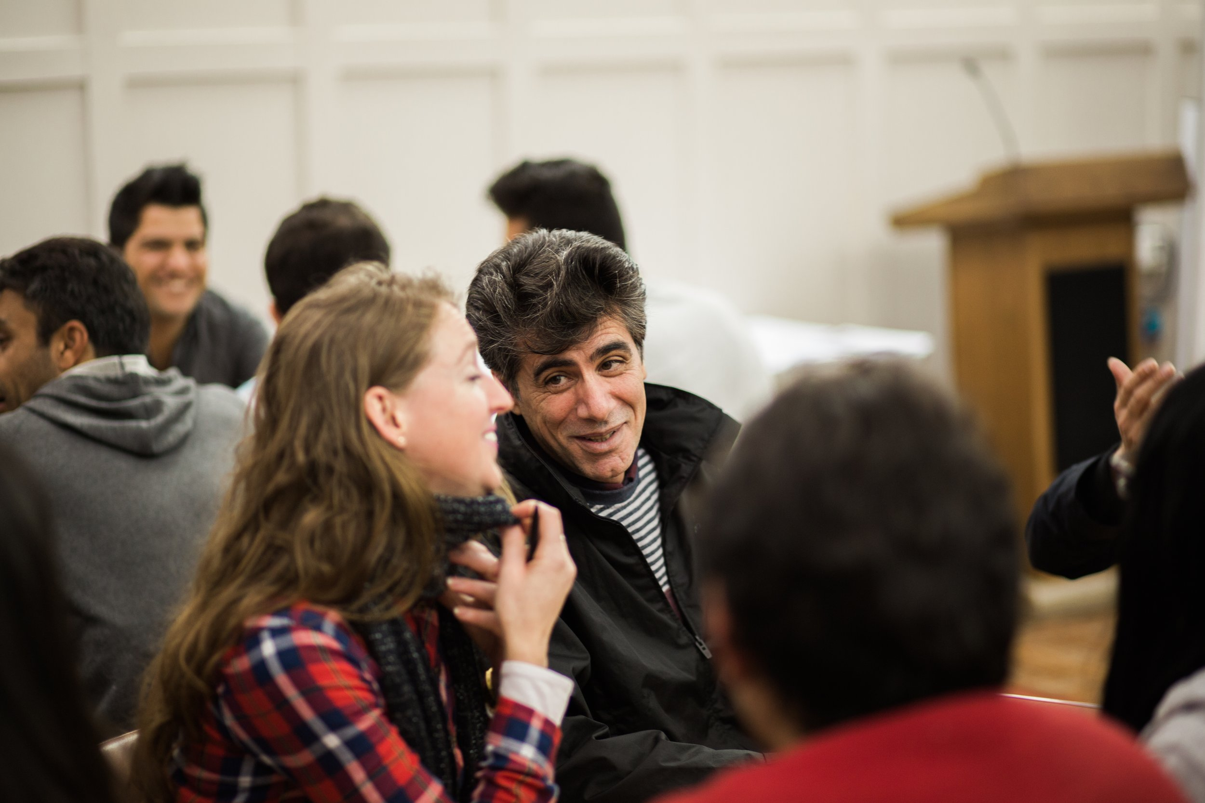

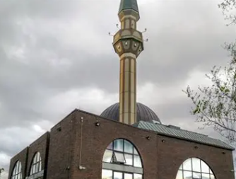

family hub
church
Community class
mosque
charity
Making friends
No exam

Slide 15

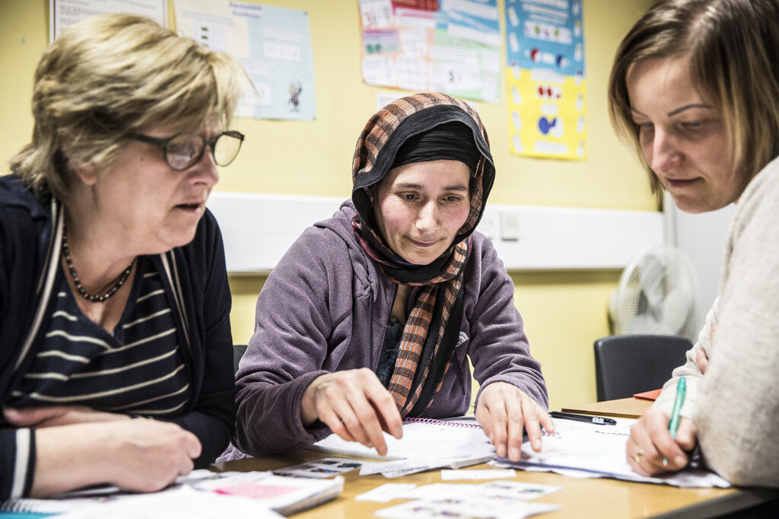
Where are they learning?
Online
In person

Slide 16
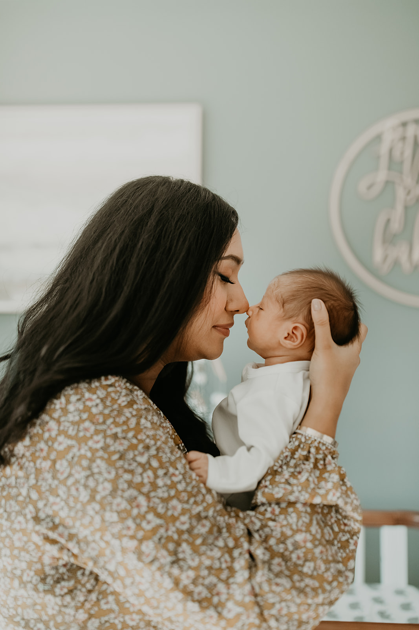
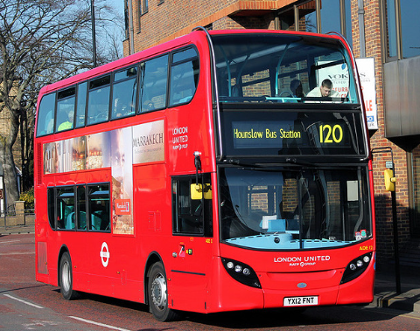

Why do you like learning online?
Transport is difficult.
I am busy with appointments.
My children.

Slide 17
Questions for you:
Why do you want to learn English?
What do you want to learn?
Where do you want to learn?
What is difficult about learning?
Notes:
Further Learning – Fill in form

